Slide 1

Rockbuster Stealth
Data Analysis

Slide 2

Overview
Rockbuster Stealth LLC:
A movie rental company that formerly had stores around the world. It plans on launching an online video rental service in order to stay competitive.
The Challenge:
The company is facing stiff competition from streaming services such as, Netflix and Amazon Prime.
Key Questions:
Which movies contributed the most/least to revenue gain?
What was the average rental duration for all videos?
Which countries are Rockbuster customers based in?
Where are customers with a high lifetime value based?
Do sales figures vary between geographic regions?

Slide 3
Top 10 Movie Titles With The Highest Revenue
The top 3 movies with the highest revenue are Telegraph Voyage, Zorro Ark, and Wife Turn.

Slide 4
Bottom 10 Movies Titles With The Least Revenue
The lowest 3 movies with the lowest revenue are Duffel Apocalypse, Oklahoma Jumanji, and Texas Watch.

Slide 5
Total Revenue By Movie Genre
The top 3 highest earning movie genres are Sports, Sci-Fi, and Animation.

Slide 6
Average Rental Duration
The average rental duration for all movies ranged from 4-6 days with the highest rental duration genres being Thriller, Travel, and Music.

Slide 7





Movie Rental Statistics
Rental Rate
Min. – $0.99
Max. – $4.99
Average – $2.98
Replacement Cost
Min. – $9.99
Max. – $29.99
Average – $19.98
Movie Length
Min. – 46 minutes
Max. – 185 minutes
Average – 115 minutes
Rental Duration
Min. – 3
Max. – 7
Average – 5

Slide 8
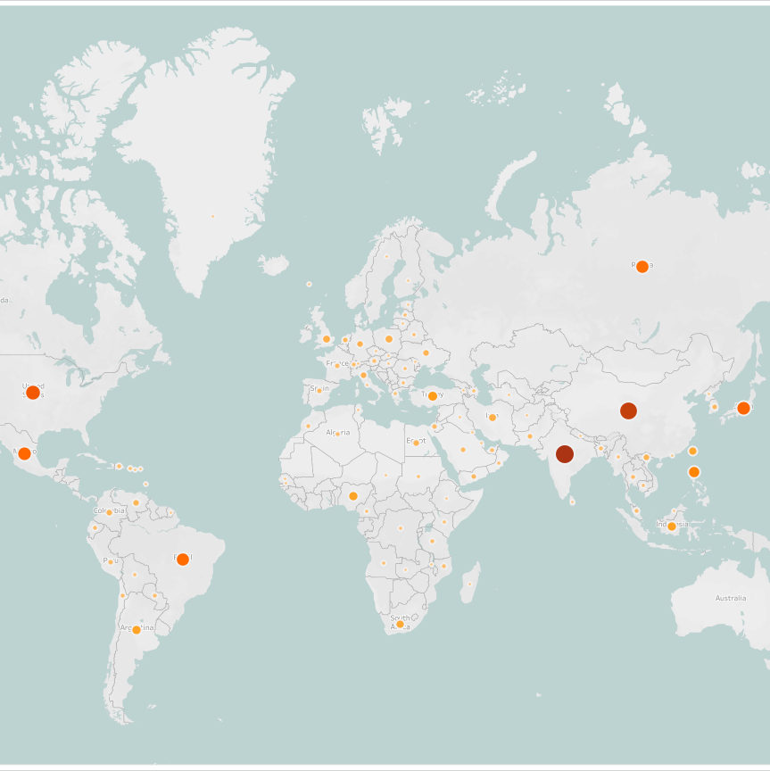
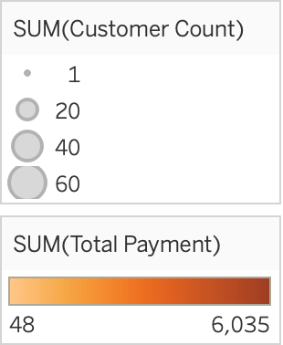
Customers Based By Country
The map shows the number of Rockbuster customers per country and India, China, and the United States are the top 3 countries who have the highest number of customer’s and are the highest paying customers.

Slide 9

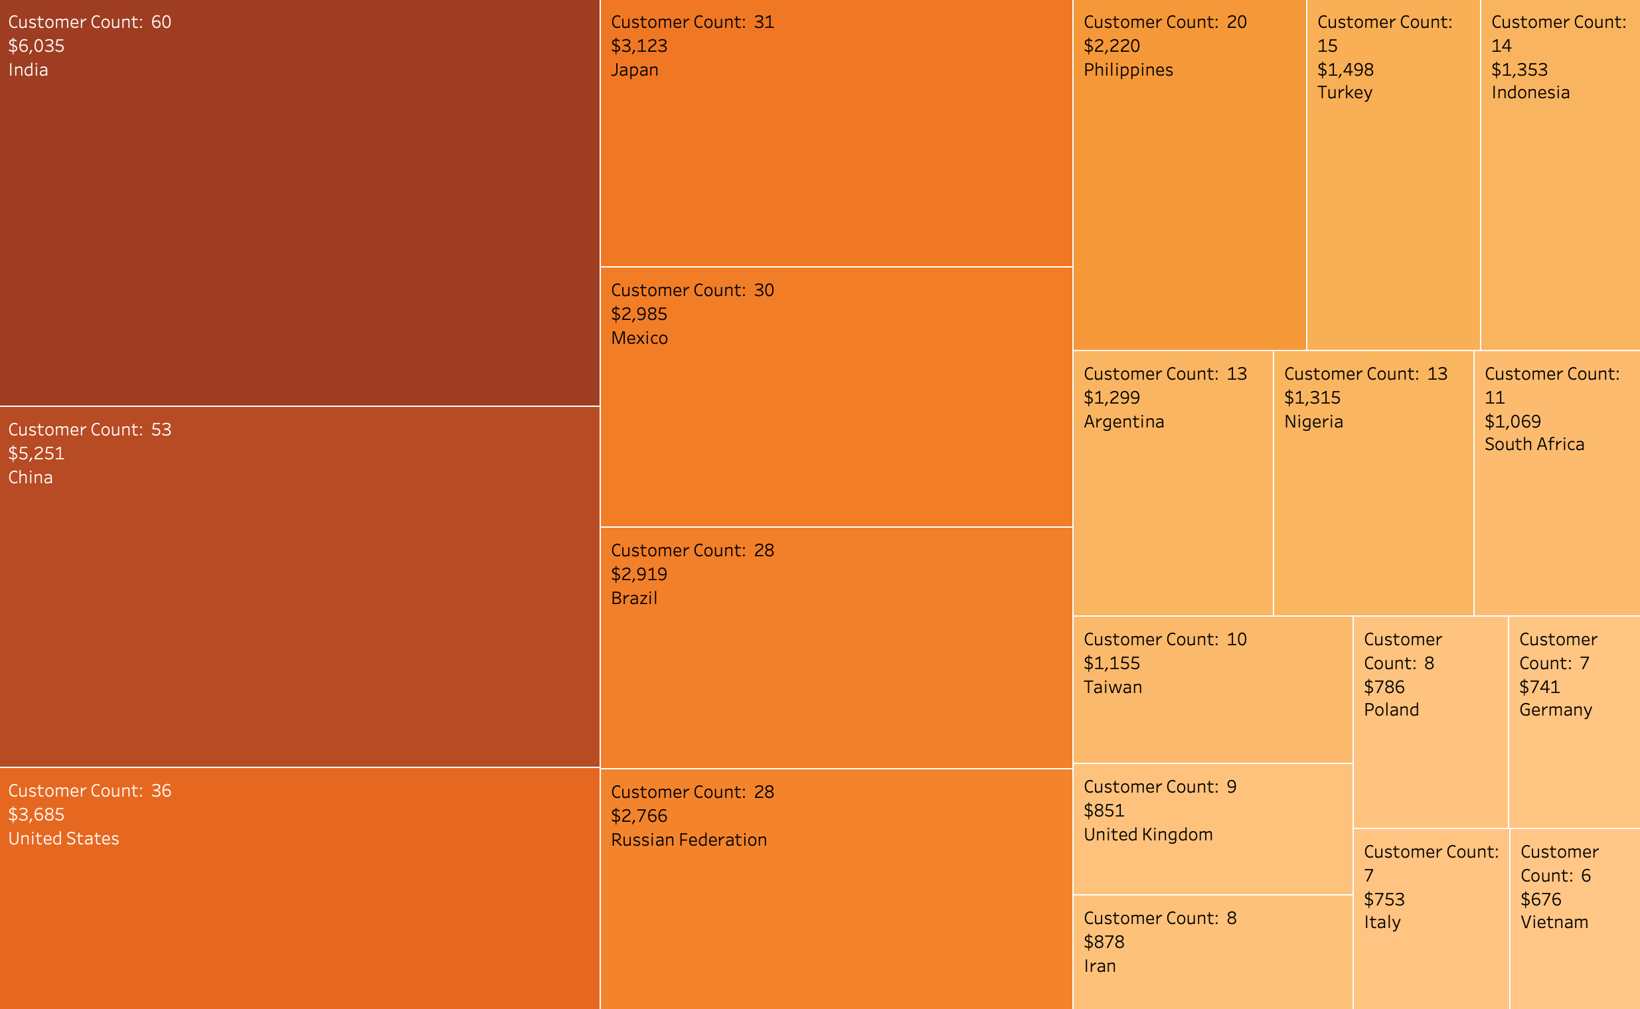
High Lifetime Customers
The top 3 countries with the highest total revenue and customers include:
India
China
United States
The bottom 3 countries with the lowest total revenue and customers include:
Germany
Italy
Vietnam

Slide 10
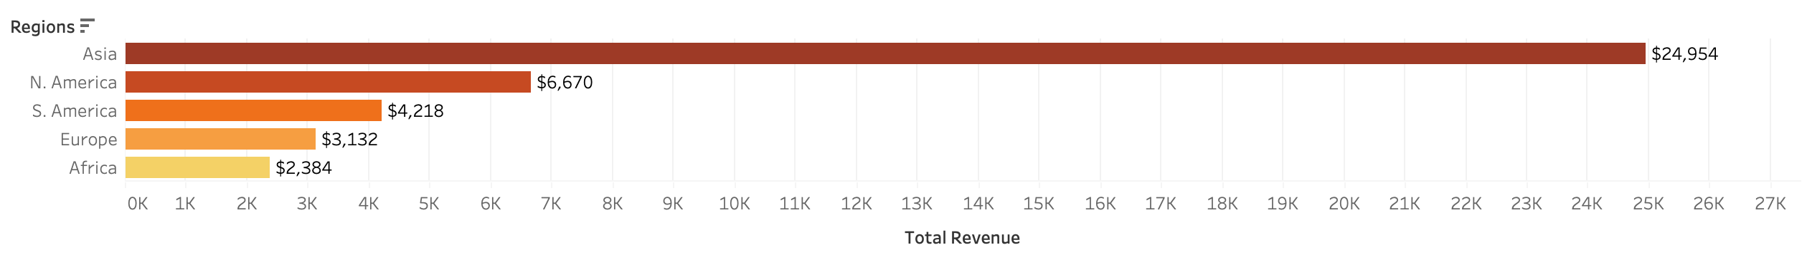
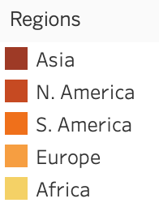
Geographic Region Sales
The following bar chart below shows the total revenue of Rockbuster sales by geographic region. Asia has the highest number of sales, followed by North and South America.
Total Revenue: $41, 358.45

Slide 11
Summary And Recommendations
Summary
Most profitable regions: Asia, North America, and South America.
Top movie genres: Sports, Sci-Fi, and Animation.
Highest customer count: India, China, and United states.
Recommendations
Focus on marketing and promotion of services to Asian regions, following the other regions.
Target marketing and promotion of high revenue genres such as, Sports, Sci-Fi, and Animation.
Reward loyal customers by offering them discounts on rentals or subscription plans.
Have a diverse inventory of movies genres.
Extend rental duration at a reduced cost
Eliminate low revenue movie titles to maximize high revenue movie titles

